Slide 1
Predikcija ishoda IVF postupaka u žena s niskim serumskim vrijednostima AMH
Miro Šimun Alebić
Odjel za humanu reprodukciju
Klinika za ženske bolesti i porode
KB Merkur

Slide 2
AMH
Anti-Müllerian hormone (AMH)
  dimeric glycoprotein, a member of the transforming growth factor-beta superfamily (Jost, 1946; Cate et al., 1986)
  In women,
    produced by granulosa cells of pre-antral and small antral follicles (Weenen et al., 2004)
    main physiological role - inhibition of the early stages of follicular development (Themmen, 2005; Visser and Themmen, 2005).

Slide 3
AMH
AMH – prediction of ovarian response
  in prediction of the number of oocytes retrieved basal AMH serum levels are, at least, as good as antral follicle count (AFC) (Broer et al., 2008, La Marca et al., 2010)

Slide 4
Pregnancy chances
  oocyte yield: positively affects the pregnancy chances (Ulug et al., 2003; Baka et al., 2006; Timeva et al., 2006)
  poor responders have a lower pregnancy rate compared with normal responders (Biljan et al., 2000; de Sutter and Dhont, 2003; Galey-Fontaine et al., 2005; Baka et al., 2006; Timeva et al.,2006; van der Gaast et al., 2006; Saldeen et al., 2007; Hendriks et al., 2008; Zhen et al., 2008)

Slide 5
POOR
poor ovarian response (POOR) is associated
  mainly,
    reduced number of FSH-sensitive follicles, most frequently linked to the condition known as diminished ovarian reserve.
  rarely,
    suboptimal exposure to gonadotrophins (Maheshwari et al.,2007)
    FSH hyposensitivity (FSH receptor subtypes less sensitive to exogenous gonadotrophins (Simoni et al., 2002).

Slide 6
Pregnancy chances in POORs
POOR definition requires, at least, 1 IVF cycle (Ferrareti et al., 2011)
identiﬁcation of those among poor responders who still have an acceptable prognosis
counseling on whether it is worthwhile to start or continue with IVF (Oudendijk et al., 2012)

Slide 7
Pregnancy chances in POORs
BMI: >30 kg/m² negatively influence the pregnancy chances (Orvieto et al., 2009)
FSH: >12 IU/L significantly lowers the pregnancy rates (Galey-Fontaine et al., 2005)

Slide 8
Expected POOR
expected POOR could be diagnosed BEFORE first IVF cycle according to AMH, AFC…
AMH – prediction of POOR
  in response to FSH, reported sensitivity and specificity ranged between 44–97% and 41–100%, respectively (La Marca et al., 2010)

Slide 9
Pregnancy chances
  AMH is not suitable to be used as a single predictor of pregnancy chances following IVF (Broer et al., 2009; Weghofer et al.,2011; Ferraretti et al., 2011)
  age: negatively associated with pregnancy chances (Hanoch et al., 1998; de Sutter and Dhont, 2003; Ulug et al.,2003; aley-Fontaine et al., 2005; Zhen et al., 2008)

Slide 10
Pregnancy chances before first IVF cycle
  multivariate age-AMH model significantly improved LB prediction accuracy of both univariate and age models
  ROC-AUC_{AMH-age} 0.66 (95% CI 0.61–0.72) vs
  ROC-AUC_{AMH} 0.57, (95% CI 0.52–0.61,P<0.05) and
  ROC-AUC_{age}(95% CI 0.52–0.59,P<0.05)
in the same age category, AMH is able to distinguish between pregnancy and non-pregnancy (La Marca et al., 2011)

Slide 11
Research
in the same AMH and age category, there are still patients who achieve pregnancy and those who do not
is it possible to identify those with acceptable pregnancy prospects among expected POORs prior to the first IVF cycle?

Slide 12
Research
Objective:
  to investigate
    whether any of the endocrine and/or clinical characteristic (s) obtainable prior to the first (GnRH antagonist )IVF cycle could improve the accuracy of IVF outcome prediction based on the female age alone in expected poor responders (by low AMH levels)
  to identify parameter(s) able to discriminate patients with favorable and unfavorable prognosis within the same age and AMH category

Slide 13
Uvod
groundwork (N=1088):
    the optimal cut-off for the number of oocytes retrieved (NOR) to discriminate between pregnancy and non- pregnancy
    - AUC 0,61; 95% CI 0,58-0,64; P<0,001
    <3 oocytes:
    +LR for non-pregnancy of 2.82; 95%CI 2.0 - 4.0

Slide 14
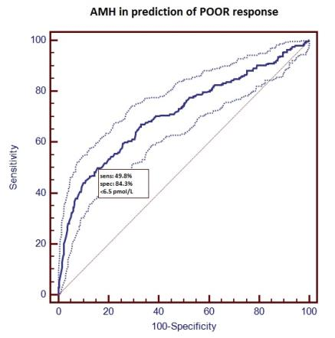
Research
groundwork
  to set the AMH cut-off for POOR (<3 oocytes):
  AUC= 0,71; 95% CI 0,68- 0,74; P<0,001;
  <6.5 pmol/L
  +LR 3.18; 95%CI 2.6 - 3.9

Slide 15
Istraživanje
M&M:
Inclusion criteria:
serum AMH concentration <6.5 pmol/L
null gravidity
normal uterus and uterine cavity
no history of pelvic disease or surgery
no history of the use of medications that could interfere with basal hormone status,
sperm count of, at least, 1 × 10⁶ /mL
first IVF/ICSI cycle,
AMH and other laboratory tests values obtained within three months preceding controlled ovarian stimulation,
a fixed dose of 300 I.U. hMG from the day 3; GnRH antagonist protocol
N=129

Slide 16
Research
main outcome:
  AUC-ROC of model combining age and other potential predictive factors for the clinical pregnancy.
study design:
  retrospective study

Slide 17
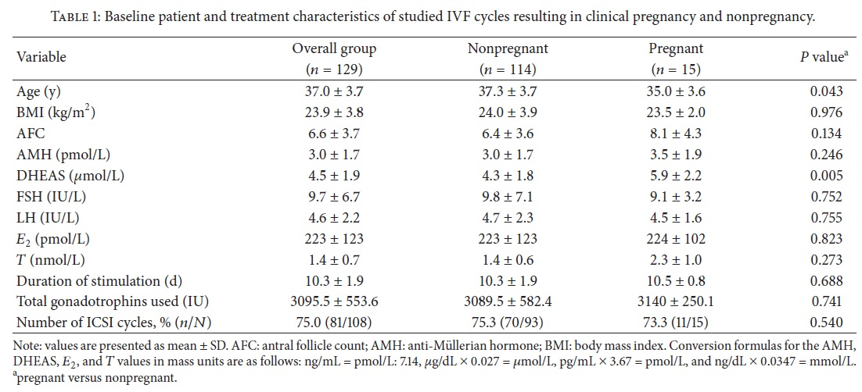
Research

Slide 18
Research
LRA:
  univariate showed significant predictive power for both, age and DHEAS
  multivariate excluded age from the predictive model leaving only DHEAS as predictive for pregnancy (DHEAS 1,59; 95%CI 1.58-2.2)
    the negative correlation between age and DHEAS could not entirely explain the association between DHEAS and pregnancy prospects
    the usefullness of continous multivarate model was failed to be demonstrated

Slide 19
Research
however, discriminative capacity of DHEAS was not demonstrated to be higher than age
  AUC-ROC_{DHEAS} 0.726 (95%CI 0.641–0.801)
  AUC-ROC_{age} 0.662 (95%CI 0.573–0.743)
    𝑃 = 0.522
              since age is an easy-to-obtain parameter, the use of DHEAS, as a single predictor, instead of age could not be advised

Slide 20
Research
therefore, according to cut-offs derived by ROC curve analysis:
  age - 37.5 y (OR=6.7; 95% CI 1.5–31.2)
  DHEAS - 5.7 𝜇mol/L (OR 7.9; 95% CI 2.5–25.4)

Slide 21
Research
the usefullness of combined age and DHEAS categoric model for pregnancy prediction was assesed by comparison with discriminative capacity of univariate age model
AUC-ROC_{age-DHEAS} 0.796 (95%CI 0.716–0.862)
AUC-ROC_{age} 0.662 (95%CI 0.573–0.743)
𝑃 = 0.013
combining information on DHEAS and age could improve the ability to predict pregnancy compared to the information of age alone

Slide 22
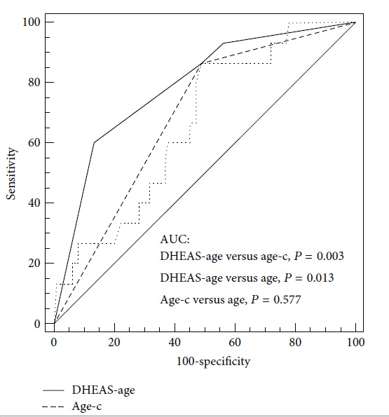
Research

Slide 23
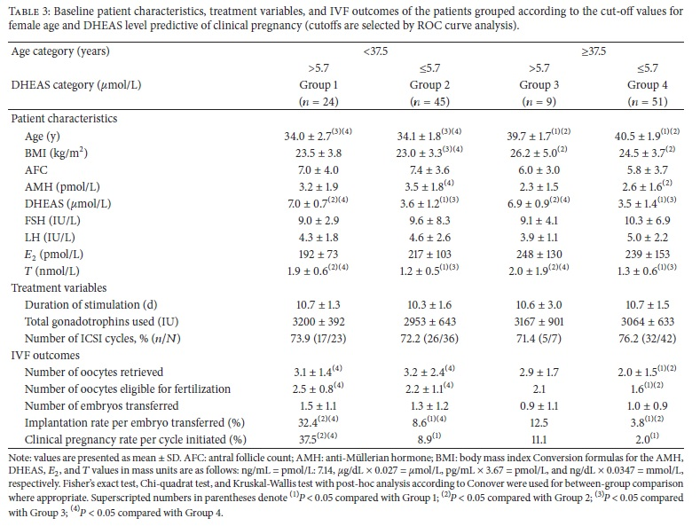
Research
P<0.05
NS

Slide 24
Research
Discussion:
DHEAS is a sulfated metabolite of DHEA and acts as a intraovarian hormone precursor for active androgens and estrogens (Casson et al., 2000)
DHEAS to DHEA conversion take place in GC- sulphatase (Bonser et al., 2000)

Slide 25
Research
Discussion:
decline linearly with age (Labrie et al., 1997)
may have beneficial effect on age-related conditions (van Muhlen et al., 2007)
the beneficial effect of DHEA supplementation in some patients with diminished ovarian reserve (Gleicher and Barad, 2011).

Slide 26
Research
Discussion:
potentialy, sufficient quantities of DHEAS and its metabolites in the oocyte microenviroment are needed to ensure adequate steroidogenesis and sufficient oocyte quality

Slide 27
Research
Discussion:
hipotheticaly, DHEAS deficiency in younger patients reduce their pregnancy chances to the level inherent to the higher age categories

Slide 28
Research
Discussion:
not all poor responders are similar in terms of loss of oocyte quality
the link between remaining quantity of antral follicles and the quality of the oocytes held within these follicles is missing (Oudendijk et al., 2012)

Slide 29
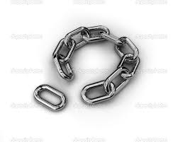
Research
Discussion:
DHEA(S)?

Slide 30
Research
Conclusion:
adding information on DHEAS to female age could improve the prediction of clinical pregnancy prior to the first IVF cycles
improved counseling accuracy regarding the probabilities for successful IVF treatment in women with low AMH who were younger than 37.5 years
hypotheticaly, observed association between DHEAS and pregnancy chances could be explained by the association of DHEAS and oocyte quality

Slide 31
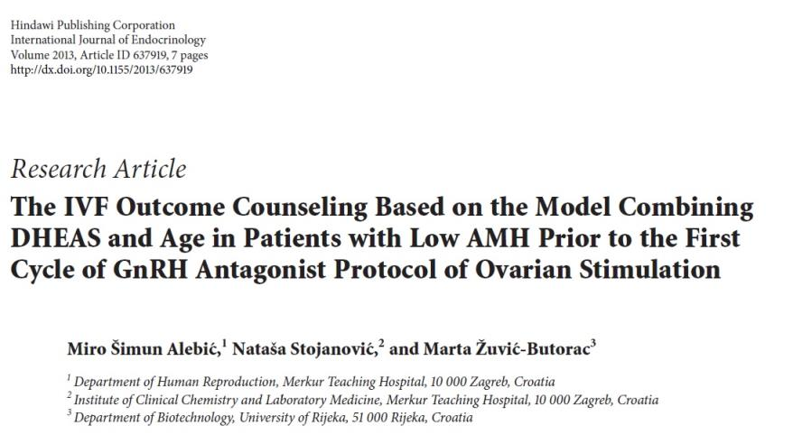
Research

Slide 32


Reprodukcijski tim KB Merkur

